Slide 1
Conceptual Modeling University Hiring Example

Slide 2
Hiring Example
You wish to develop a database to keep track of new instructor hires for departments within a university: who they are and when they were hired. An instructor can be hired by more than one department, not necessarily at the same time, so you would like to know the date of hire. Each instructor has a set of skills. The university wants to be able to track which skills an instructor possesses, as well as basic data about instructors and departments. It is not necessary to include a University entity, but if you do, make some reasonable assumptions about what attributes to include in the database.
Draw a conceptual model (entity-relationship model) to represent this real- world situation. Use both the Chen notation and the Crow’s Feet notation.
Transform the conceptual model to a relational model.

Slide 3
Hiring Example
You wish to develop a database to keep track of new instructor hires for departments within a university: who they are and when they were hired. An instructor can be hired by more than one department, not necessarily at the same time. Each instructor has a set of skills. The university wants to be able to track which skills an instructor possesses, as well as basic data about instructors and departments. It is not necessary to include a University entity, but if you do, make some reasonable assumptions about what attributes to include in the database.
Draw a conceptual model (entity-relationship model) to represent this real- world situation. Use both the Chen notation and the Crow’s Feet notation.

Slide 4
Entity-Relationship Model: Chen Notation
U.Name
date founded
max enrollment
address
University
(1,N)
name
date-of-hire
name
comprised
of
DeptID
EmpID
email
location
(1,1)
Department
(1,N)
hires
(1,M)
Instructor
(1,N)
has
Skill-ID
(0,N)
Skill
description

Slide 5
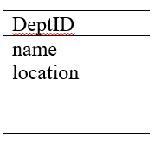
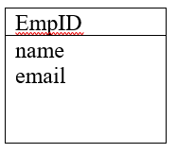
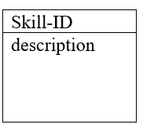
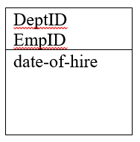
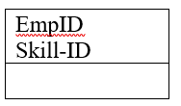
Entity-relationship Model: Crow’s Feet Notation
University
Department
Instructor
Skill
U-Name
date-founded
max enrollment address
Department-Instructor
Instructor-Skill

Slide 6
Relational Model University: (U-Name, date_founded, max enrollment, address) Department: (DeptID, name, lovation, U-Name) Instructor: (EmpID, name, email) Skill: (Skill_Id, description) Department_Instructor: (DeptID, EmpID) Instructor_Skill: (EmpID, Skill_Id)
University
Department
Instructor
Skill
U-Name
date-founded
max enrollment address
Department-Instructor
Instructor-Skill

